Slide 1

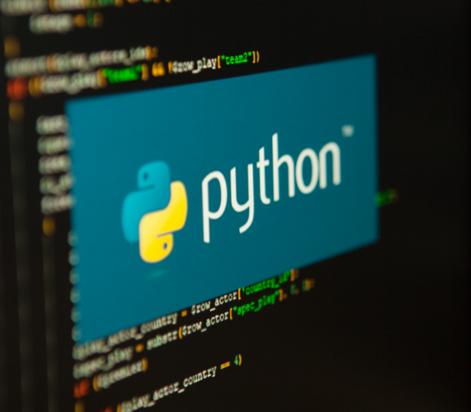

Python…… Explore to Data World
https://www.anaconda.com/download

Slide 2
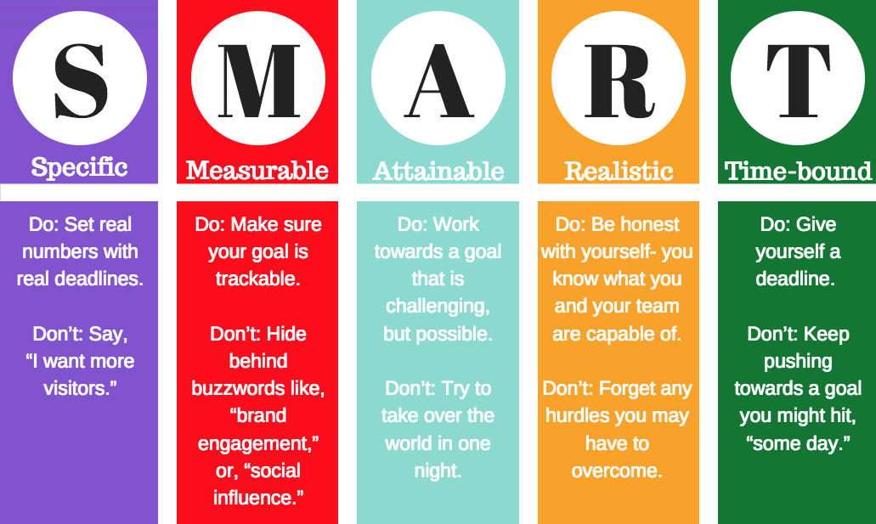
Learning Objectives:
Introduction to Python
Functions
Iterables and Conditional Statement
Modules
Python Strings
Python Dates and Times
Math
File Processing
Exception Handling
OOPS in Python
Playing with Data
NumPy, Pandas, Matplotlib,Seaborn
Data Analysis Using Statistical Models
https://www.anaconda.com/download

Slide 3
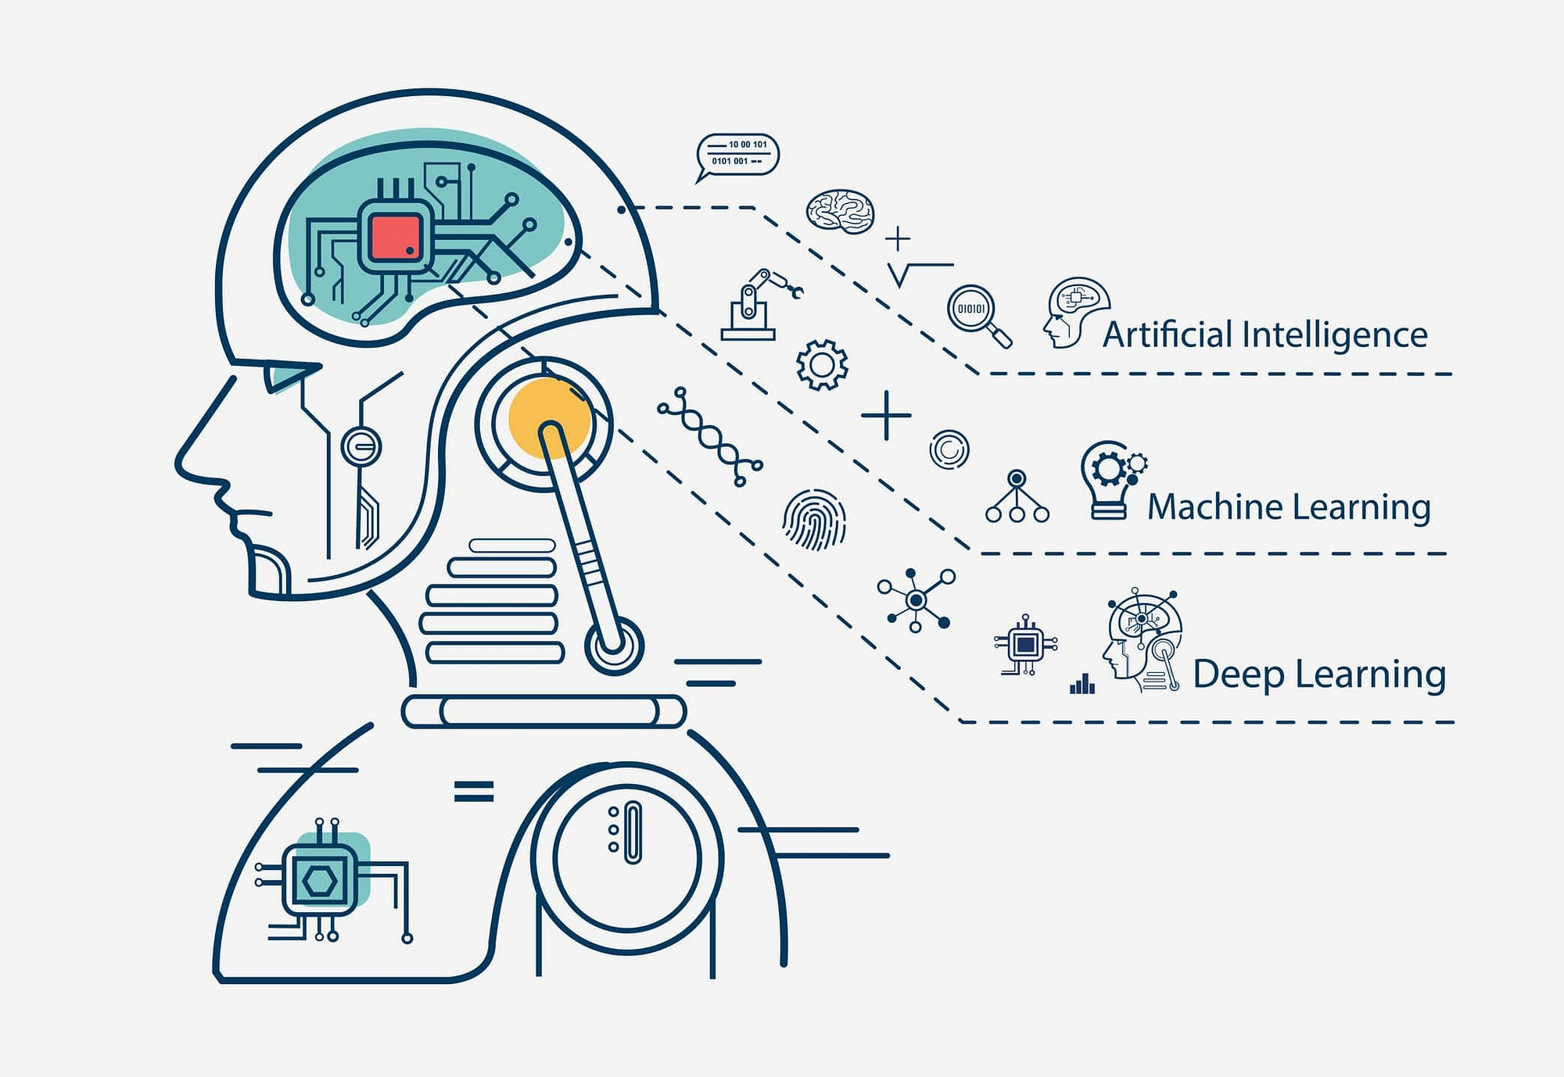
Learning Outcomes:
Upon successful completion of this training, participants will be able to:
Write Basic Python Programs
Manipulate Data Structures
Implement Control Flow Logic
Solve Problems with Functions
Handle Errors and Exceptions
Work with Files
Develop Confidence in Writing Python Code
Collaborate with Other Developers
Prepare for Intermediate Python Topics: Lay the foundation for exploring
more advanced topics such as object-oriented programming, libraries, and frameworks used in Python.
https://www.anaconda.com/download

Slide 4
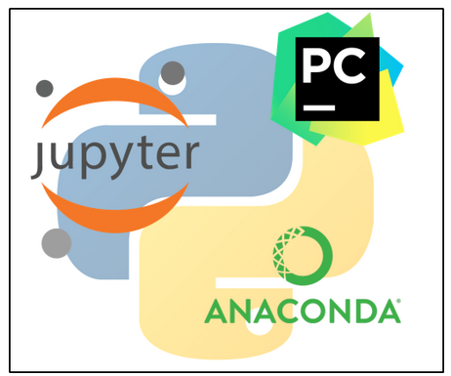
Python programming language is one of the most popular programming languages in the world right now. With the ease of access and easier implementations of complex-looking tasks, the Python programing language has made its mark in the IT industry.
The scalability of the Python programming language is immense and can be implemented almost in every domain. Data Science has reached another milestone with Python, and the amount of data flowing in each year, Python came as a savior and helped achieve revolutionary developments in the Data Science market.
Getting Started With Python
Walk Through

Slide 5
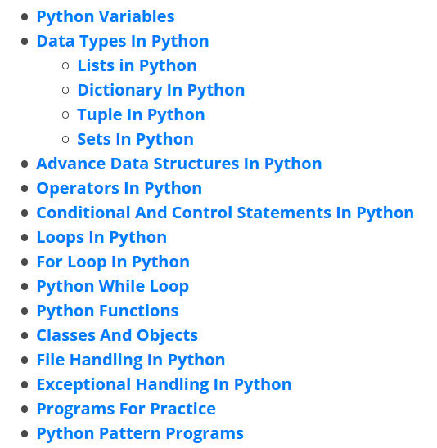
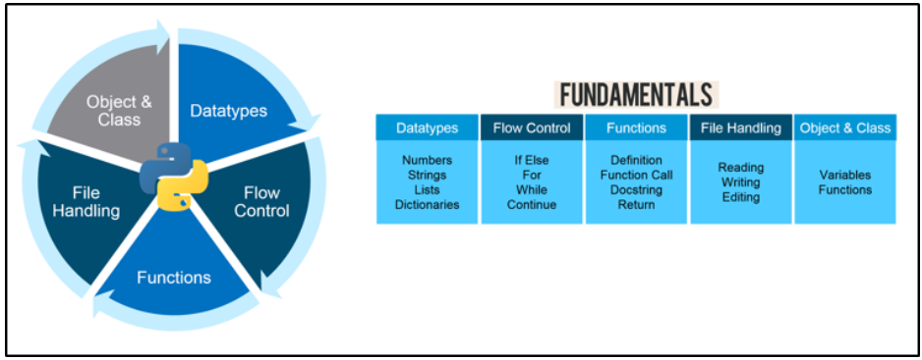
Python Basics
After setting up the Python environment, installing suitable IDEs begin learning with the very basics. Even though the basics are pretty similar to any other programming language, but it’s required to learn Python from basics as well to build strong debugging and scripting skills.

Slide 6
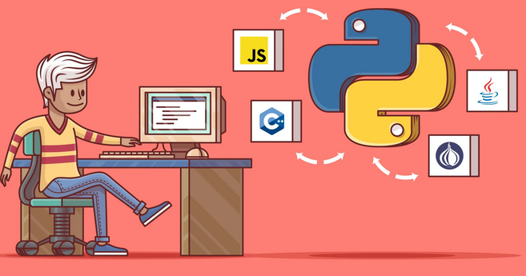
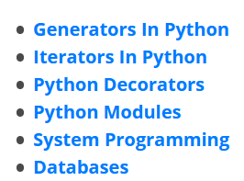
Advanced Python Concepts
Advanced concepts in Python that will give you a clearer perspective on how things are done with Python with advanced Python concepts.

Slide 7
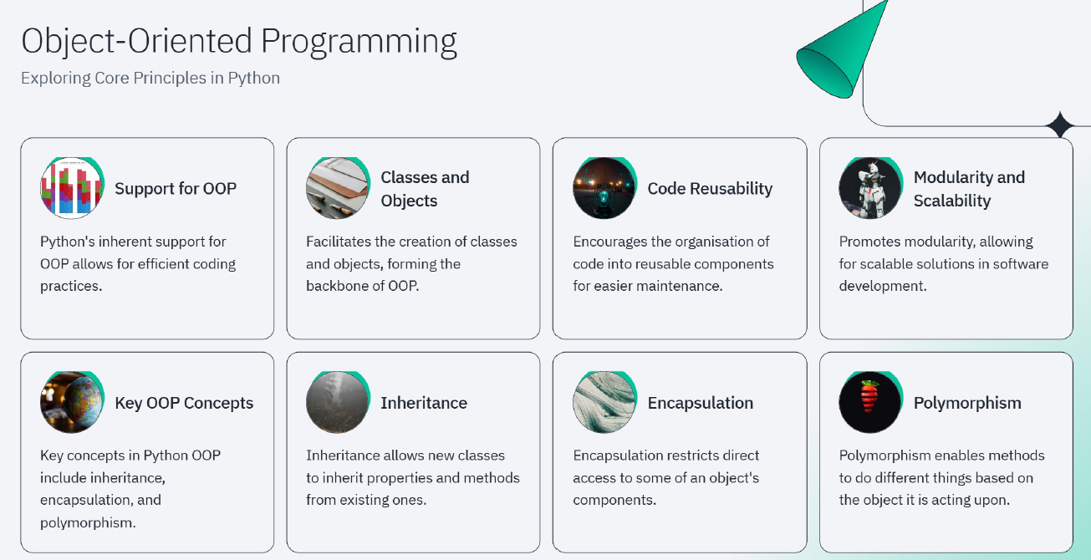

Slide 8
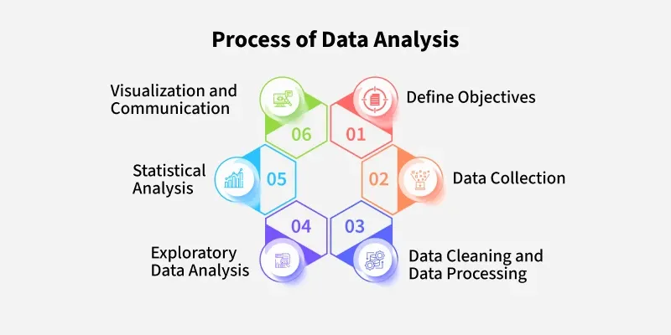
Data analysis using Python involves leveraging the language's extensive libraries and tools to extract insights, clean, manipulate, and visualize data.
Types of Data Analysis:
Descriptive Analysis: Describes the features of a dataset, summarizing its main characteristics. Common tools include mean, median, standard deviation, and various visualizations (e.g., histograms).
Diagnostic Analysis: Focuses on understanding why something happened by identifying patterns or relationships in the data. This type of analysis might look for correlations between variables.
Predictive Analysis: Uses historical data to predict future events. Techniques like regression analysis, time-series forecasting, and machine learning models are used to make predictions.
Prescriptive Analysis: Suggests actions that should be taken. It often uses advanced techniques such as optimization algorithms, simulations, and decision analysis to recommend strategies.
Inferential Analysis: Involves making predictions or generalizations about a population based on a sample of data. Statistical tests like t-tests, ANOVA, or chi-square tests are commonly used.

Slide 9

Jump into Python World !!!!

Slide 10
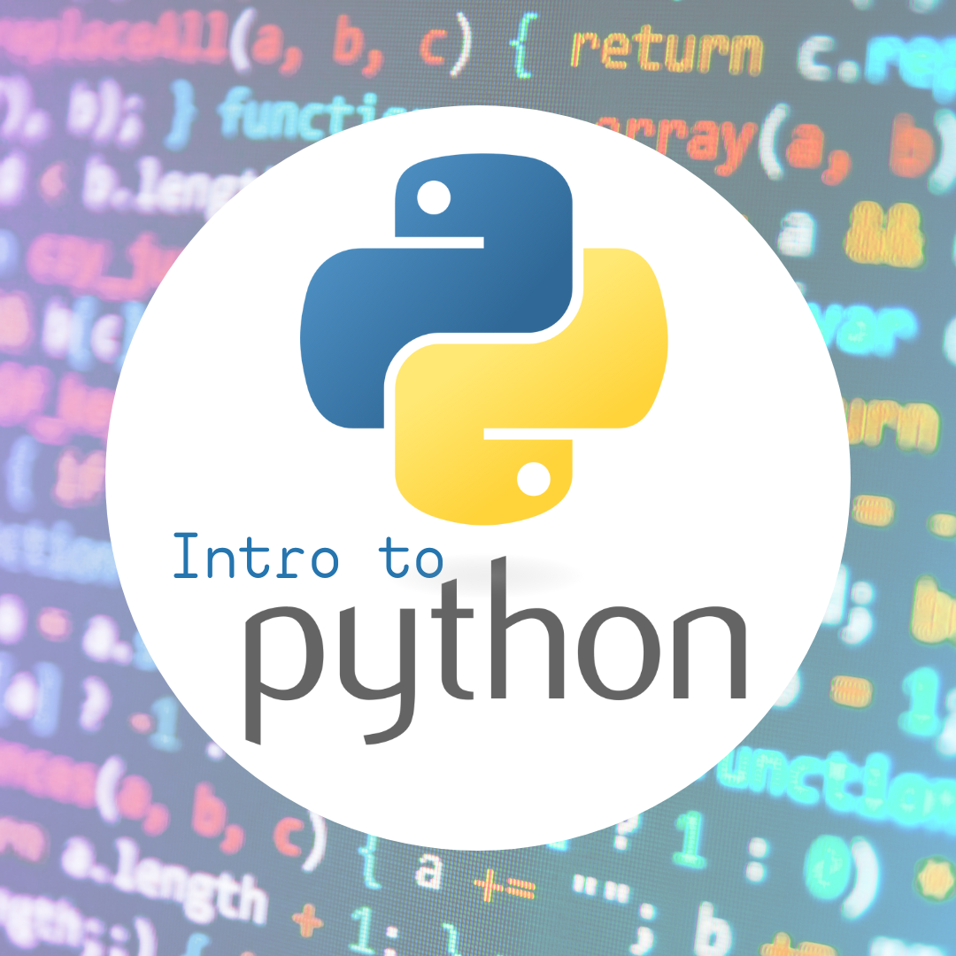
Introduction to Python
• Introduction to Python • Overview Python Based Applications • Environment Setup • Data Types • Variables and its Scope • Data Structure • Operations on Data Structure • Input and Output Operation • Writing a Python Module

Slide 11
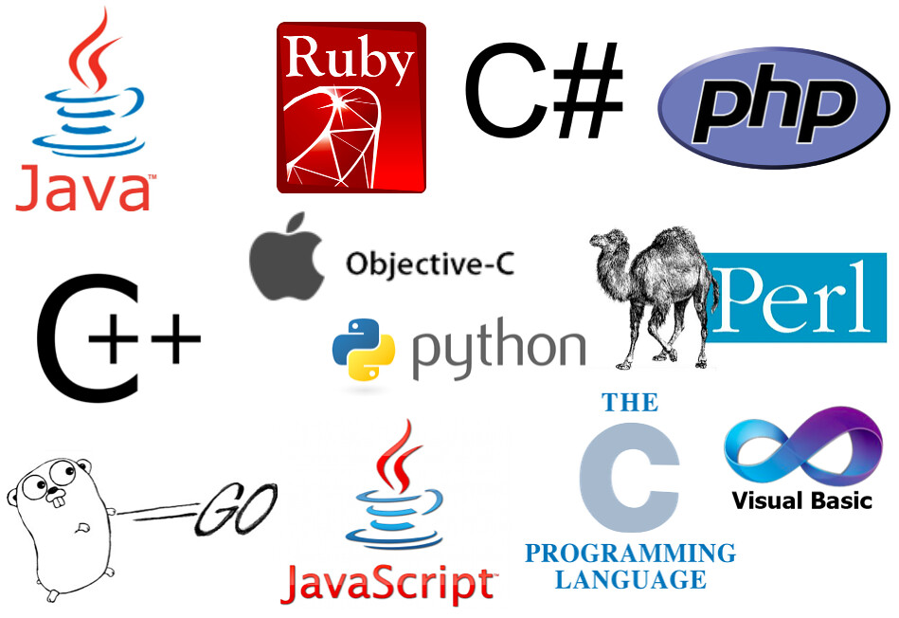
Programming is the process of creating a set of instructions that tell a computer how to perform a task. Programmers write code in a variety of programming languages to develop software, websites, apps, and other computer-based technologies.

Slide 12
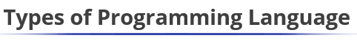
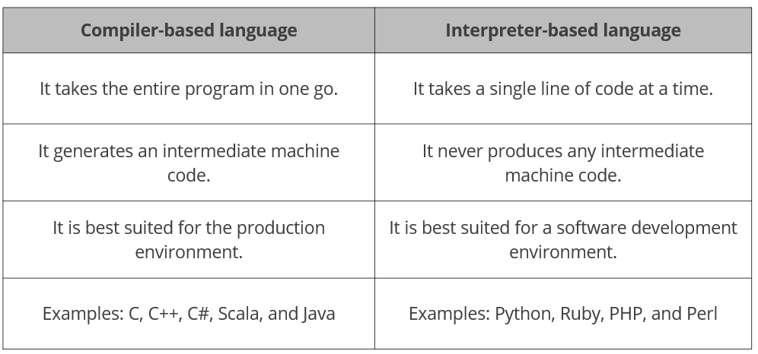

Slide 13
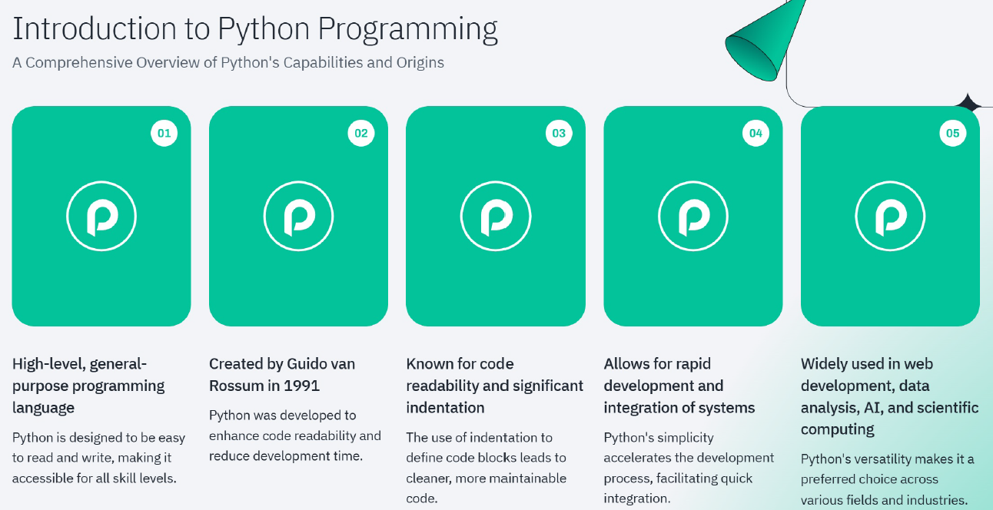

Slide 14
Advantage of Python
Some of the key advantages of learning Python:
Python is Interpreted − Python is processed at runtime by the interpreter. You do not need to compile your program before executing it. This is similar to PERL and PHP.
Python is Interactive − You can actually sit at a Python prompt and interact with the interpreter directly to write your programs.
Python is Object-Oriented − Python supports Object-Oriented style or technique of programming that encapsulates code within objects.
Python is a Beginner's Language − Python is a great language for the beginner-level programmers and supports the development of a wide range of applications from simple text processing to WWW browsers to games.

Slide 15
Characteristics of Python
Following are important characteristics of Python Programming −
It supports functional and structured programming methods as well as OOP.
It can be used as a scripting language or can be compiled to byte-code for building large applications.
It provides very high-level dynamic data types and supports dynamic type checking.
It supports automatic garbage collection.
It can be easily integrated with C, C++, COM, ActiveX, CORBA, and Java.

Slide 16
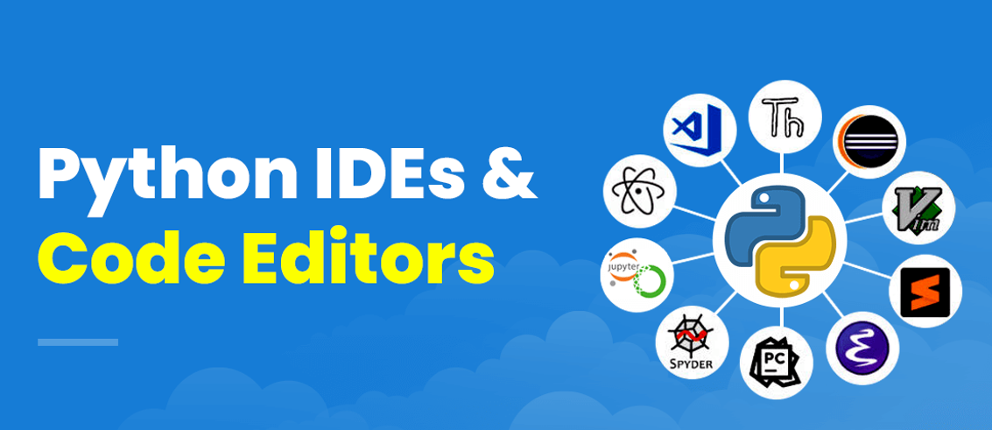
Python IDEs (Integrated Development Environments) are software applications that provide comprehensive facilities to computer programmers for software development. They simplify the coding process by integrating essential tools into a single environment.

Slide 17
Python - Basic Syntax
First Python Program
print("Hello Python World")
Python Identifiers
A Python identifier is a name used to identify a variable, function, class, module or other object. An identifier starts with a letter A to Z or a to z or an underscore (_) followed by zero or more letters, underscores and digits (0 to 9).
Python does not allow punctuation characters such as @, $, and % within identifiers. Python is a case sensitive programming language. Thus, Manpower and manpower are two different identifiers in Python.

Slide 18


Slide 19
1. Who is the creator of Python?
A) Dennis Ritchie B) James Gosling C) Guido van Rossum D) Bjarne Stroustrup
Answer: C Explanation: Python was created by Guido van Rossum in the late 1980s and released in 1991.

Slide 20
2. Which of the following is not a feature of Python?
A) Interpreted language B) Object-Oriented C) Platform Dependent D) High-level language
Answer: C Explanation: Python is platform independent, not dependent.

Slide 21
3. Python is often called:
A) Strongly typed & compiled B) Weakly typed & compiled C) Interpreted and dynamically typed D) Statically typed and compiled
Answer: C Explanation: Python is interpreted and dynamically typed.

Slide 22
4. Python is widely used in AI and Machine Learning because:
A) It is slow compared to C B) It has vast libraries and easy syntax C) It does not support OOP D) It does not need data
Answer: B Explanation: Python’s libraries (NumPy, Pandas, TensorFlow, PyTorch) and simple syntax make it the top choice for AI/ML.

Slide 23
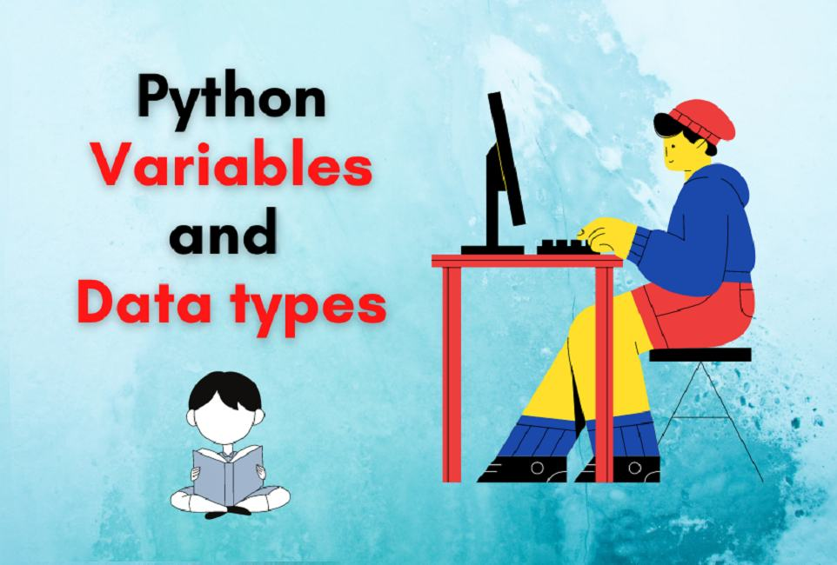

Slide 24
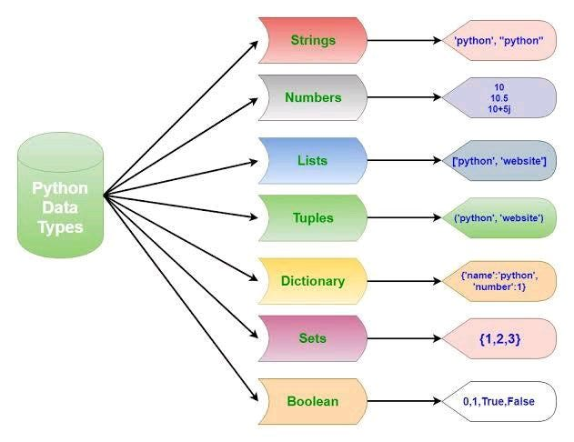
Variable and Data Structures
In other programming languages like C, C++ and Java, you will need to declare the type of variables but in Python you don’t need to do that. Just type in the variable and when values will be given to it, then it will automatically know whether the value given would be a int, float or char or even a String.
# Python program to declare variables
myNumber = 3
print(myNumber)
myNumber2 = 4.5
print(myNumber2)
myNumber ="helloworld"
print(myNumber)

Slide 25
